Slide 1


Social Buzz
Analysis Presentation
Nidhi Kumari
Data Analyst

Slide 2


Today's agenda
Project Recap
Problem
The Analytics Team
Process
Insights
Summary

Slide 3

Social Buzz is a fast growing technology unicorn that needs to adapt quickly to its global scale.
Accenture has begun a 3 month POC focusing on these tasks:-
An audit of Social Buzz’s big data practice.
Recommendations for a successful IPO.
Analysis to find Social Buzz’s top 5 most popular categories of content.
Project Recap

Slide 4

Problem
Over 1,00,000 posts per day
36,500,000 pieces of content per year!
But how to capitalize on it when there is so much?
Analysis to find Social Buzz’s top 5 most popular categories of content

Slide 5



Andrew Fleming
Chief Technical Architect
The Analytics team
Marcus Rompton
Senior Principle
Nidhi Kumari
Data Analyst

Slide 6
Process
1
Data Understanding
2
Data Cleaning
3
Data Modelling
4
Data Analysis
5
Uncover Insights

Slide 7




Insights
The analysis results shows 16 categories of post across the entire dataset. There was 1969 animals posts alone telling us there are lots of animals lover out there. The result also shows January scored the highest number of posts of 2218 which is interesting to see how active people are even after the big holiday season.

Slide 8
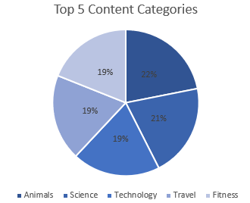
TOP 5 CONTENT CATEGORIES
The top 5 most popular categories of content were animals, science, healthy eating, technology and food.

Slide 9

Animal and science are two most popular content categories with healthy eating ranking at third. We recommend to boost user engagements.
Healthy eating can be placed in the same category as food, we suggest collaborating with healthy food brands to help bring brand awareness and to reach wider audience.
Also, Technology is in top 5, collaborating through brand partnership with tech companies will definitely increase engagement rates.
Summary

Slide 10
Thank you!
ANY QUESTIONS?

